Slide 1
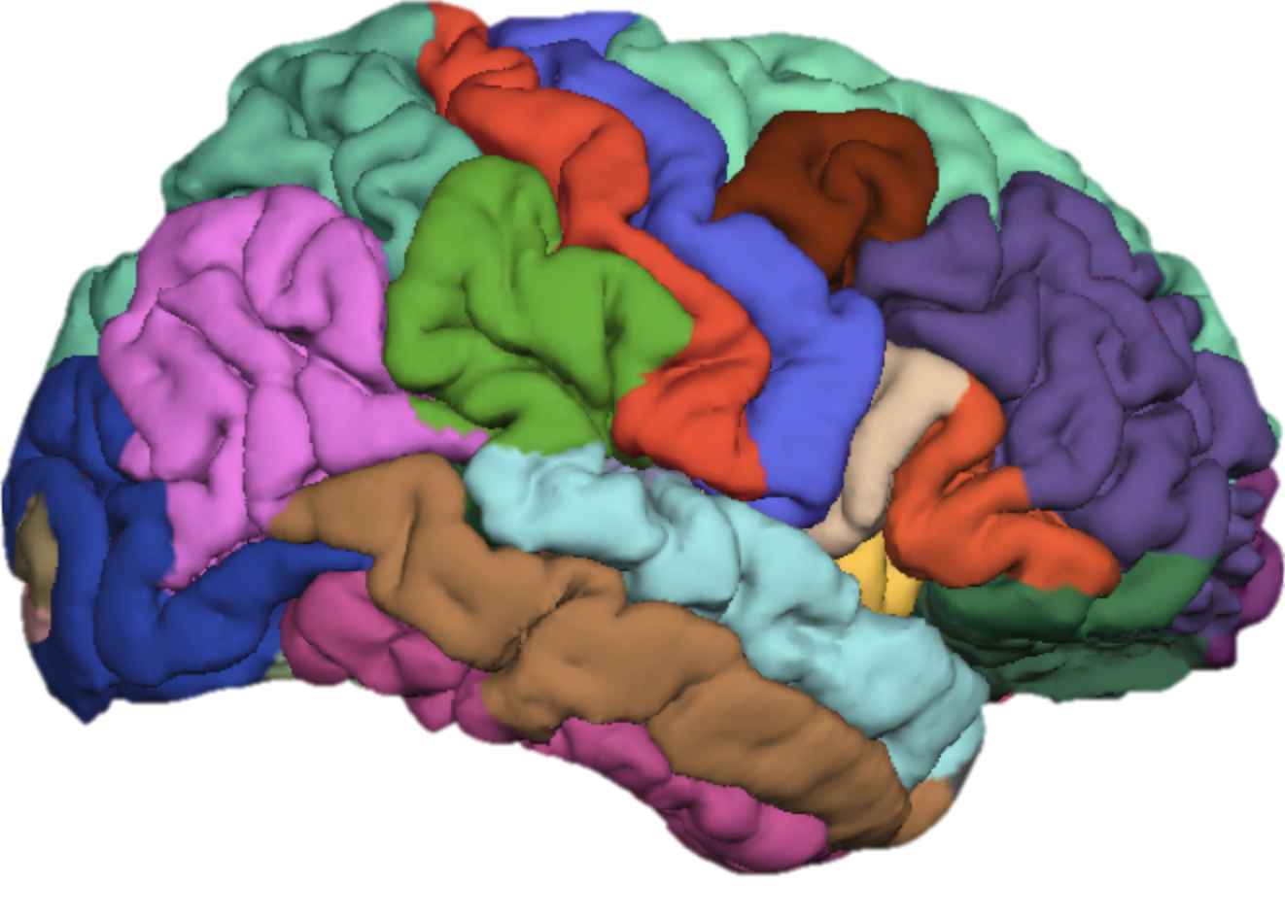
FreeSurfer Class 2: Raw Image Processing (autorecon1)
Cat Camacho
1/23/17
11:00am-12:30pm

Slide 2
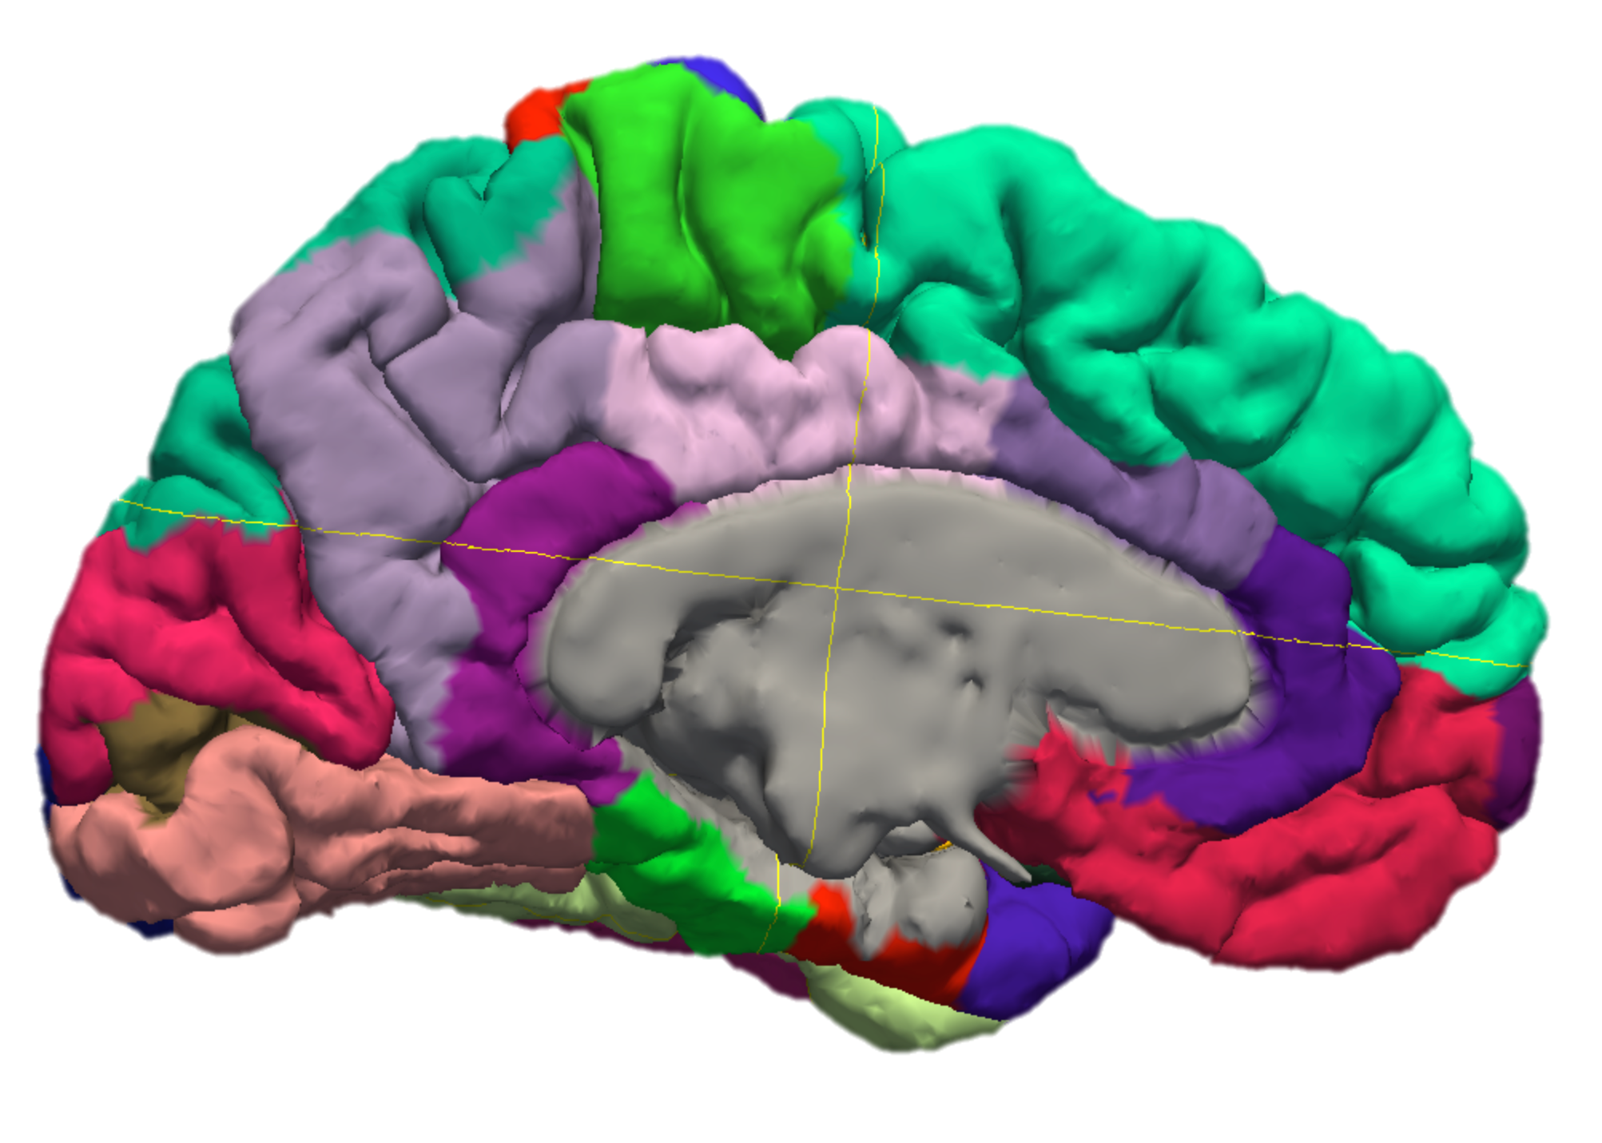
Goals for Today
Check in about install
How was it running Monica’s brain?
Raw image processing
FreeSurfer autorecon1 components
Tkregister2
TKMedit

Slide 3
recon-all outputs
mri
orig/001.mgz: the original uncorrected image
T1.mgz: Motion/artifact corrected image
brainmask.mgz: The skullstripped volume used in subsequent steps
scripts
recon-all-status.log: Summary log of the recon-all process
recon-all.log: Detailed log of the recon-all process
recon-all.done: This file gets created once recon-all is complete
Notes:
Pull up each volume in tkmedit

Slide 4
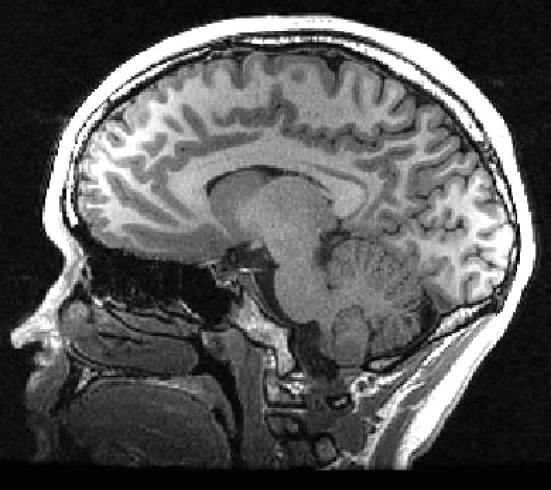
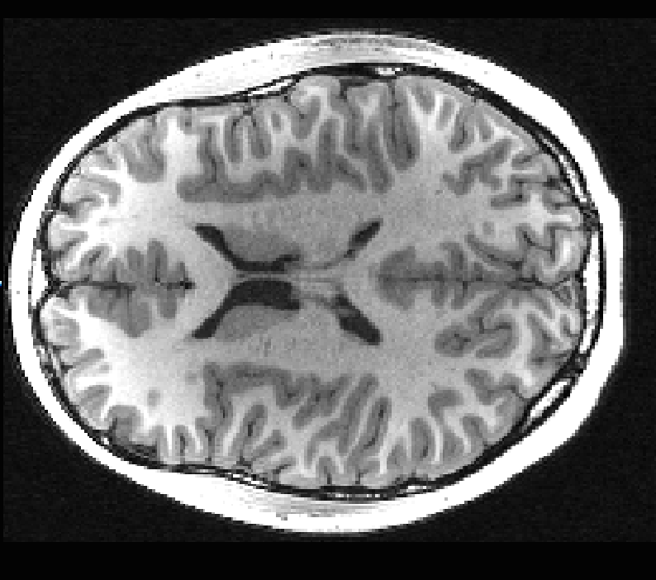
Raw Images
There is usually some kind of inhomogeneity
Factors that influence contrast:
Subject head placement
Sequence PSD
Subject motion
Magnetic field homogeneity
Artifacts create problems for processing because tissue that should have comparable T1 may be encoded very differently (see right)

Slide 5
Processing Steps (autorecon1)
1. Motion Correction
2. Talairach Registration
3. Non-uniform (NU) intensity correction
4. Normalization
5. Skull-stripping

Slide 6
autorecon1 only
To only run autorecon1 (~30 min):
T/CSH:
>> setenv SUBJECTS_DIR /home/catcam1/FS_Class/subjDir
>> recon-all -s Monica -i /home/catcam1/FS_Class/raw/Monica/Monica_T1w_1.nii.gz -autorecon1
BASH:
>> export SUBJECTS_DIR=/home/catcam1/FS_Class/subjDir
>> recon-all -s Monica -i /home/catcam1/FS_Class/raw/Monica/Monica_T1w_1.nii.gz -autorecon1
To re-run autorecon1 for an existing subject:
T/CSH:
>> setenv SUBJECTS_DIR /home/catcam1/FS_Class/subjDir
>> recon-all -s Monica -autorecon1
BASH:
>> export SUBJECTS_DIR=/home/catcam1/FS_Class/subjDir
>> recon-all -s Monica -autorecon1

Slide 7
“Motion” Correction
Motion correction is applied when multiple volumes are acquired.
If only 1 volume is entered, no motion correction is done (mri_robust_template is effectively skipped).
Motion is in quotes because FreeSurfer actually averages the volumes. It doesn’t do motion correction in the fMRI sense.
FS Component Commands | Input | Output | What it does
mri_robust_template | 001.mgz, etc. | rawavg.mgz | averages the input volumes
mri_convert | rawavg.mgz | orig.mgz | resample to 1mm³ voxels
mri_add_xform_to_header | orig.mgz | orig.mgz | Extracts orientation data

Slide 8
Talairach Registration
Puts the brain into Talairach coordinate space:
FreeSurfer performs first round of NU correction to remove magnetic bias
FreeSurfer then anchors the AC and PC
Finally it performs the transformation
FS Component Commands | Input | Output | What it does
mri_nu_correct.mni | orig.mgz | orig_nu.mgz | corrects magnetic bias
talairach_avi | orig_nu.mgz | talairach.auto.xfm | performs registration
talairach_afd | talairach.auto.xfm | orig.mgz | applies the registration

Slide 9
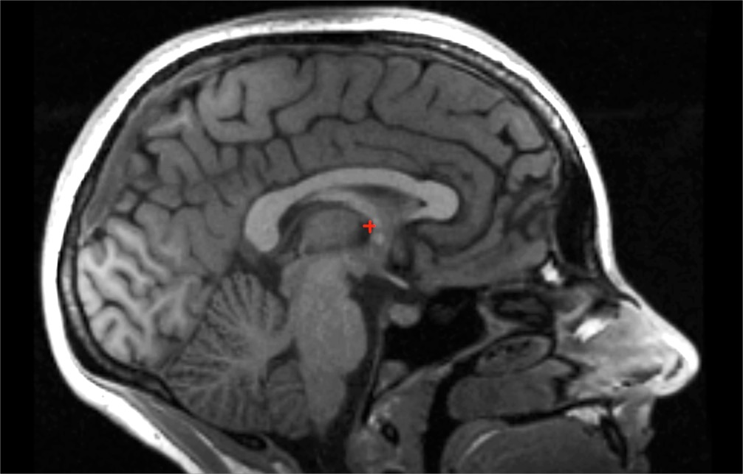
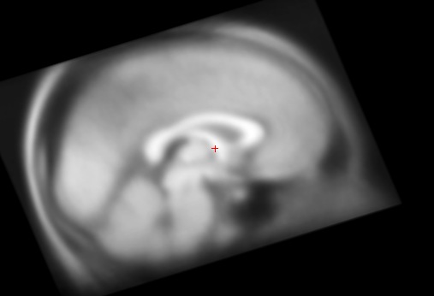
Talairach Space
Originally created to study lesions
Used to map the brain based on proportional distance from the AC-PC anchors
Was created on 1 post-mortem adult brain (which can create a small issue for younger brains)

Slide 10
Checking Registration
Since we are dealing with high-resolution scans, registration is generally good. It becomes obvious downstream when registration is wrong.
Signs that registration may need to be fixed:
Talairach registration fails altogether
FreeSurfer exits with errors
Skull-strip misses large chunks of skull
Skull-strip removes large chunks of brain
e.g. A round head + artifacts = brain registered as skull
To check/fix registration:
>> tkregister2 --mgz --s Monica --fstal
Once fixed, redo skull-strip:
>> recon-all -s Monica -all -clean-bm

Slide 11
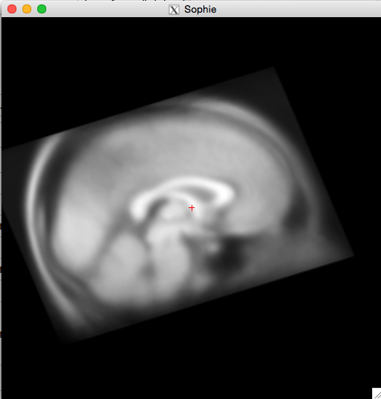
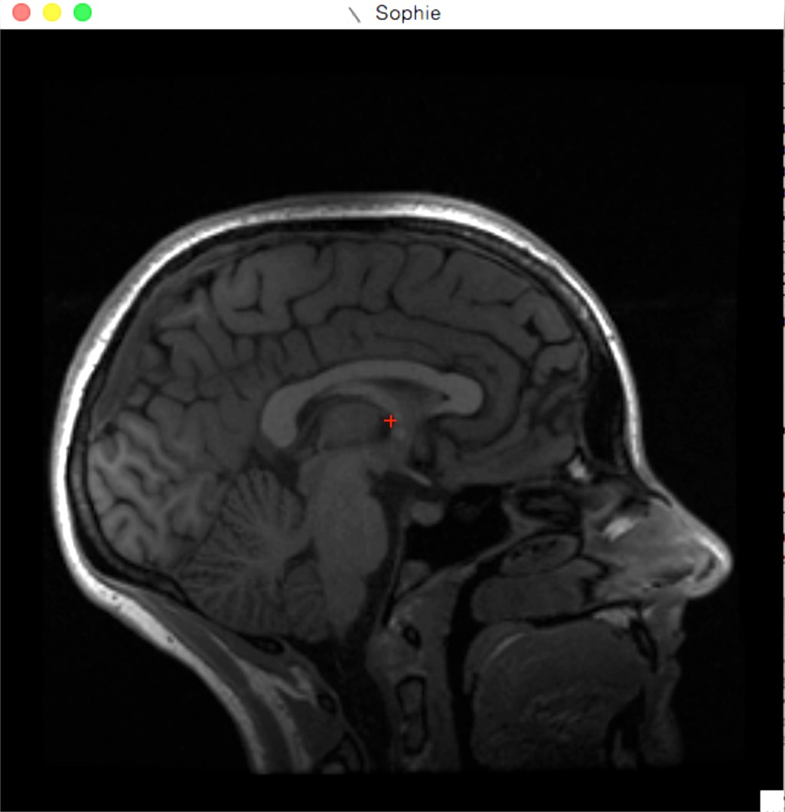
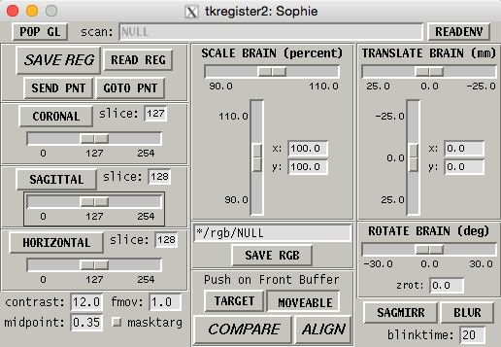
tkregister2 GUI
MNI 305 Brain
Subject Brain
manipulate shape and alignment
Navigate planes and slices

Slide 12
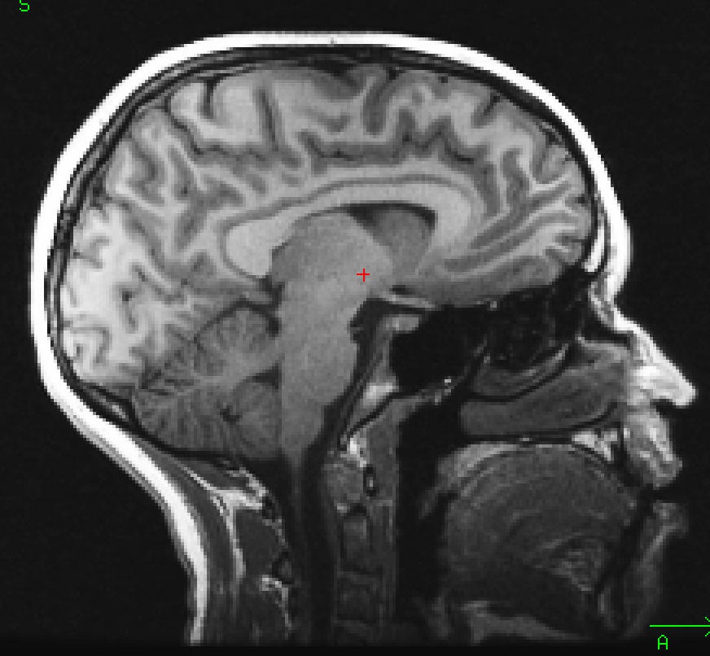
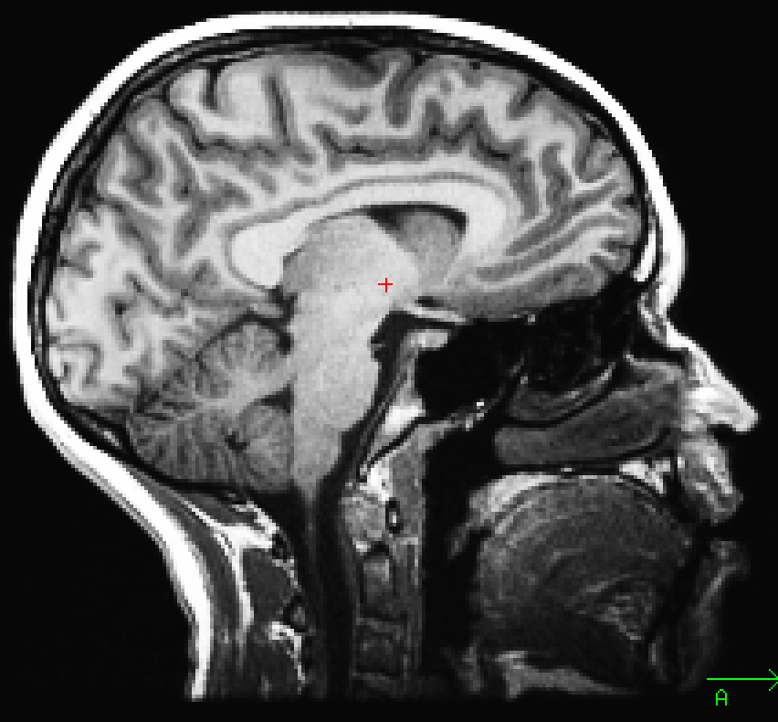
NU Correction
Before
Applies non-parametric non-uniform normalization (N3) bias correction (uses MINC nu_correct)
Applies 4 iterations of correction to maximize effectiveness
After
FS Component Commands | Input | Output | What it does
mri_nu_correct.mni | orig.mgz, talairach.xfm | nu.mgz | Non-uniform intensity correction of talairach space brain

Slide 13
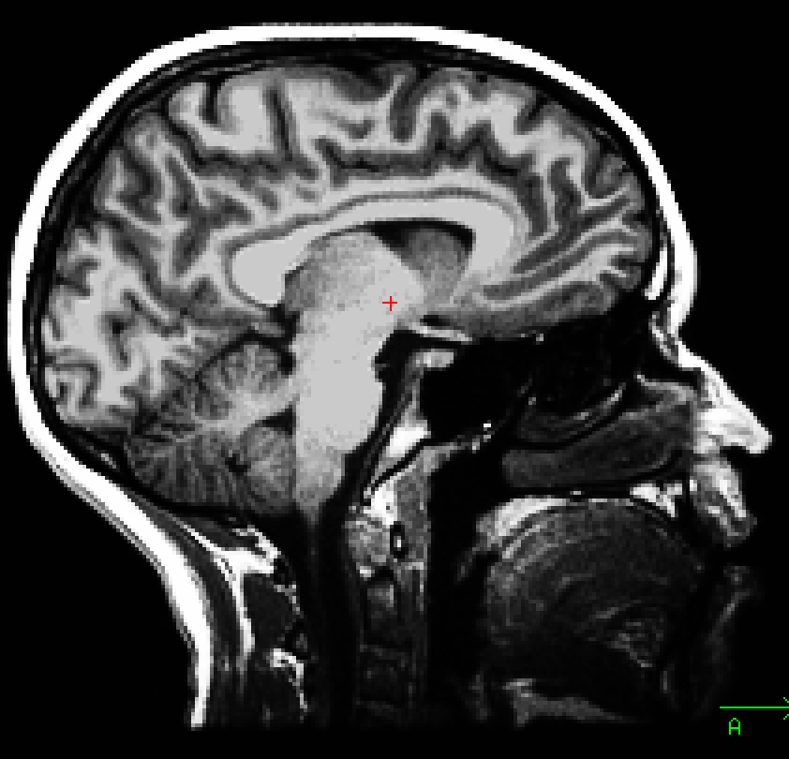
Normalization
Resamples intensities of all voxels such that WM voxels are a mean of 110.
Restricting the voxel range enables faster and more accurate segmentation.
This step is vital for all downstream processing!
Before
After
FS Component Commands | Input | Output | What it does
mri_normalize | nu.mgz | T1.mgz | resamples intensities to standardized ranges

Slide 14
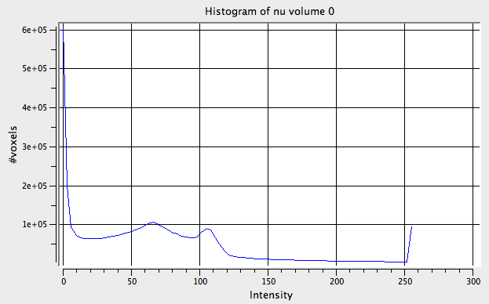
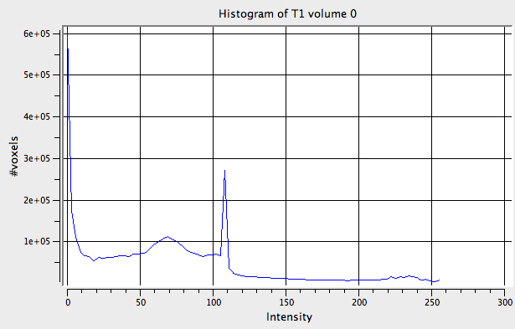
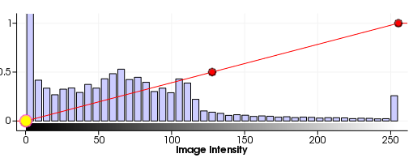
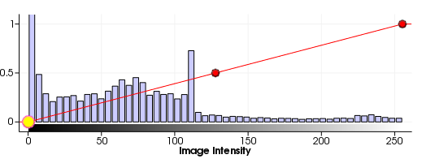
Visualizing Normalization
BEFORE
AFTER
nu.mgz
T1.mgz

Slide 15
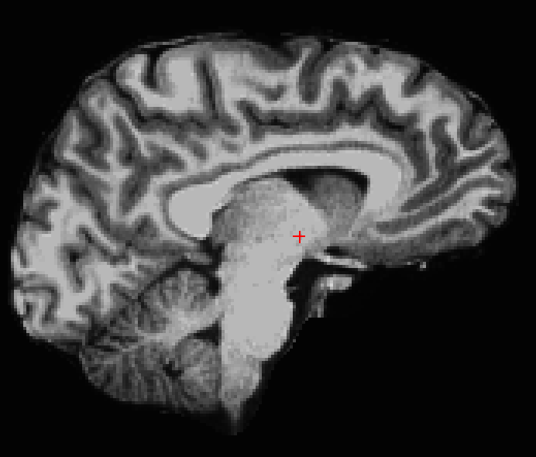
Skull-Stripping
Freesurfer removes the skull and eyes in 2 steps:
Determine probable location of skull, eyes, neck, and cortex surface based on Talairach mapping
Remove non-brain voxels
FS Component Commands | Input | Output | What it does
mri_em_register | nu.mgz | talairach_with_skull.lta | Determine major tissue ranges/locations
mri_watershed | T1.mgz | brainmask.auto.mgz | Removes non-brain tissue

Slide 16
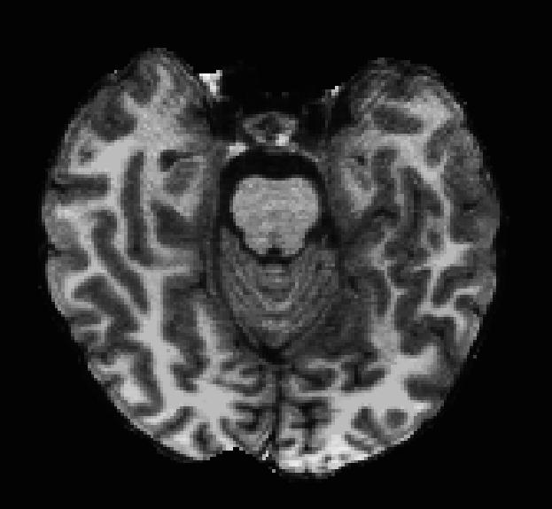
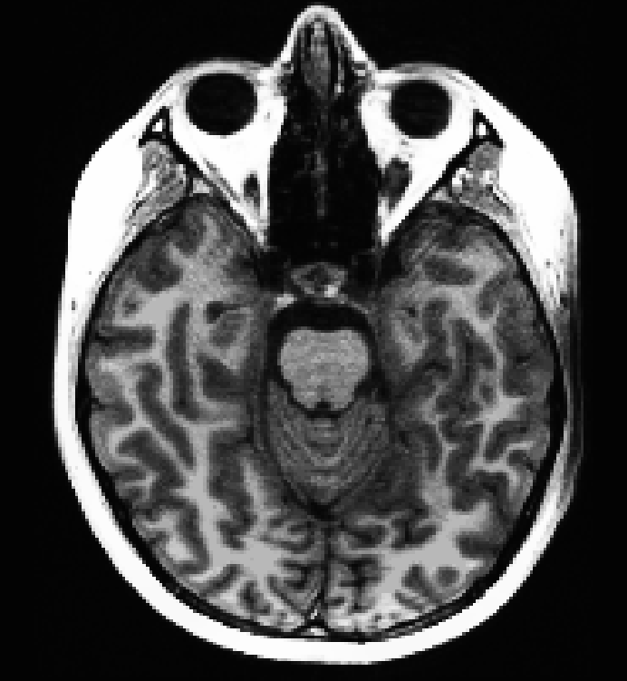
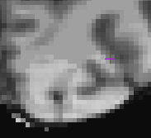
Checking Skull-stripping
You can use either TKMedit or Freeview to easily check this step
I recommend TKMedit for easy editing
Common skull-strip errors typically stem from the following issues:
Motion
Unusual head shape/size
Poor Talairach registration
Severe bias artifact
When the MRFs work against you to fix the above problems, it can mess up the skull strip

Slide 17
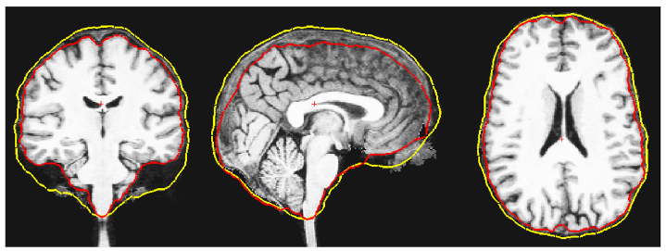
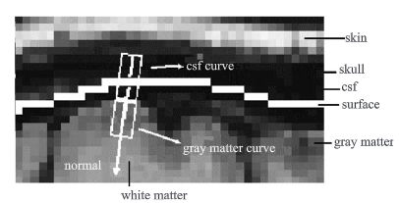
Fixing Skull-stripping
Method 1: watershed adjustment
If your entire sample is skull-stripping poorly, it may be worthwhile to play around with watershed algorithm thresholds.
This is done by adding the -wsmore, -wsless, or “-wsthresh [pctheight]” tags to the end of the recon-all command. These tags increase/decrease (wsmore/wsless) the skull surface or explicitly set a height threshold. (see below)
Ségonne F, Dale AM, Busa E, et al. A hybrid approach to the skull stripping problem in MRI. Neuroimage. 2004;22(3):1060-1075. doi:10.1016/j.neuroimage.2004.03.032.

Slide 18
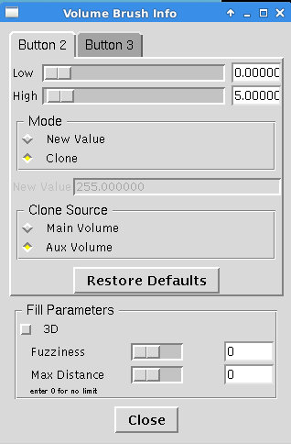
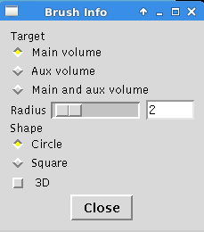
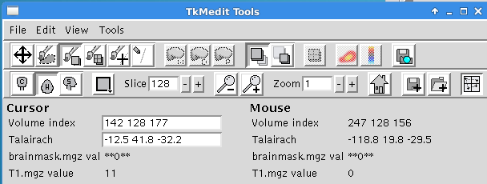
Fixing Skull-stripping
Method 2: Manual Editing using TKMedit
If a minority of your brains are not skull-stripping well, it is usually more fruitful to manually edit.
This can be accomplished by using the TKMedit GUI, loading the brainmask as a main volume and the pre-skull-strip T1 brain as the auxiliary volume:
We can then set our mouse to clone values from the aux volume to the main volume (middle click) or to delete voxels from the main volume (right click).
>> tkmedit Monica brainmask.mgz -aux T1.mgz

Slide 19
Scripting Editing Steps
Four functions in the class bin cover what we have done so far:
Batch_reconall – sequentially processes multiple subjects through recon-all
Preproc_T1w – sequentially processes multiple subjects through autorecon1
fixTal – pulls up a subject to fix Talairach registration. Re-runs autorecon1 when you save.
fixBrainMask – pulls up brainmask/T1 ready for editing (uses the tkmedit_BMedit.tcl script)
To maximize usefulness of the functions, I recommend downloading a copy of this bin for each of your studies and customizing the filepaths at the top to fit your study.

Slide 20
Recommended Practice
For next time, try out:
Running Meghan’s brain (2 input volumes, see below for an example).
Checking and adjusting Monica’s Talairach registration.
Checking and editing M&M’s brains using TKMedit
Meghan recon-all example with 2 input volumes:
>> recon-all -s Meghan -i /home/catcam1/FS_Class/raw/Meghan/Meghan_T1w_1.nii.gz -i /home/catcam1/FS_Class/raw/Meghan/Meghan_T1w_2.nii.gz -all

